Slide 1
Parallel And Distributed Computing
Presentation
Uzair Waheed Anjum
Mahrose Fatima

Slide 2
Our Topics:
Characteristics of task
Characteristics of task interaction
Mapping techniques

Slide 3
Characteristics Of Task
The first step in developing a parallel algorithm is to decompose the
problem into tasks that can be executed concurrently.
• A given problem may be decomposed into tasks in many different
ways. Tasks may be of same and different sizes.
• A decomposition can be illustrated in the form of a directed graph
with nodes corresponding to tasks and edges indicating that the
result of one task is required for processing the next. Such a graph
is called a task dependency graph

Slide 4
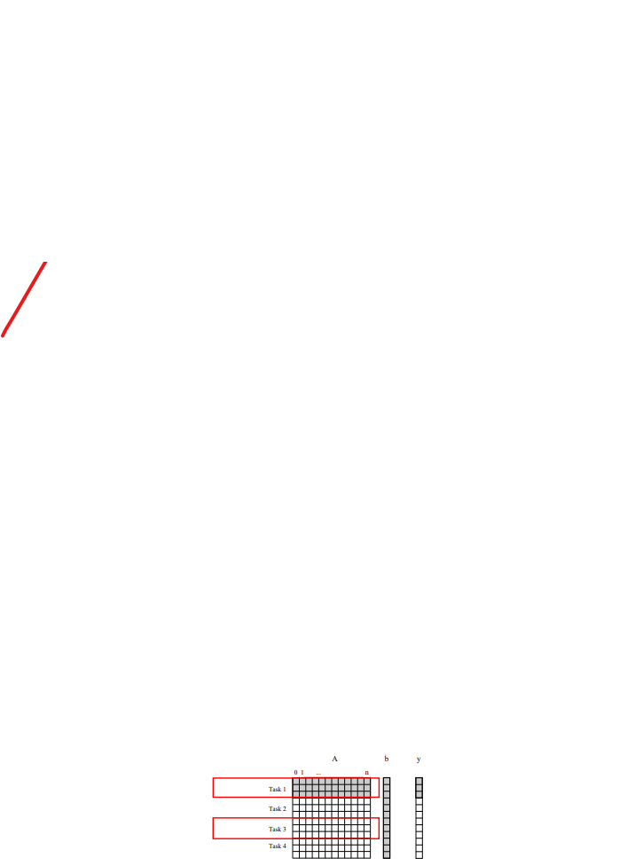
Continue…
The number of tasks into which a problem is decomposed determines its granularity.
Decomposition into a large number of tasks results in fine-grained decomposition and that into a small number of tasks results in a coarse grained decomposition.

Slide 5
Degree Of Concurrency
• A directed path in the task dependency graph represents a sequence of tasks that must be processed one after the other. The number in the node represents the workload.
• The longest such path determines the shortest time (lower bound) in which the program execution can be completed in parallel.
• The length of the longest path (sum of the workload of the nodes) in a task dependency graph is called the critical path length. What is the critical path lengths in the following 2 directed graphs?

Slide 6
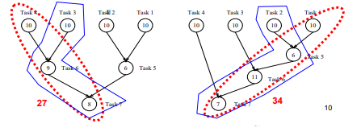
Continue…..

Slide 7
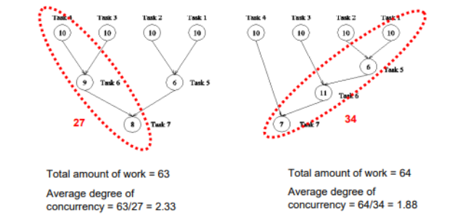
Average Degree Of Concurrency
• Defined as the ratio of total amount of work to the critical path length.

Slide 8
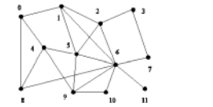
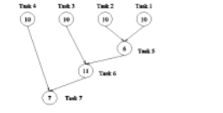
Task Interaction Graphs
Note that task interaction graphs represent data dependencies.
whereas task dependency graphs represent control dependencies.

Slide 9
Processes And Mapping
• In general, the number of tasks in a decomposition exceeds the number of processing elements available.
• Appropriate mapping of tasks to processes is critical to the parallel performance of an algorithm.
• Mappings are determined by both the task dependency and task interaction graphs.
• Task dependency graphs can be used to ensure that work is as equally spread across all processes at any point as possible (minimum idling and optimal load balance).
• Task interaction graphs can be used to make sure that processes need minimum interaction with other processes (minimum communication).

Slide 10
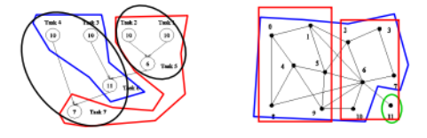
Graphs:
An appropriate mapping must minimize parallel execution time by:
• Mapping independent tasks to different processes.
• Assigning tasks on critical path to processes as soon as they become available.
• Minimizing interaction between processes by mapping tasks with dense interactions to the same process.

Slide 11
Mapping Techniques:
• Recursive Decomposition
• Data Decomposition
• Exploratory Decomposition
• Speculative Decomposition

Slide 12
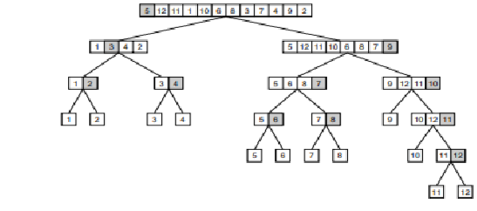
Recursive Decomposition:
Generally suited to problems that are solved using the divide-and conquer strategy.
• A given problem is first decomposed into a set of sub-problems.
• These sub-problems are recursively decomposed further until a desired granularity is reached.
• A classic example of a divide-and-conquer algorithm on which we can apply recursive decomposition is Quicksort.

Slide 13
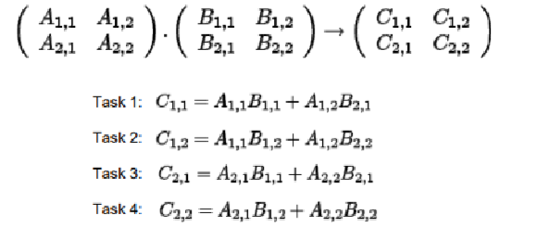
Data Decomposition:
• Identify the data on which computations are performed.
• Partition this data across various tasks.
• This partitioning induces a decomposition of the problem.
• Data can be partitioned in various ways - this critically impacts performance of a parallel algorithm.

Slide 14
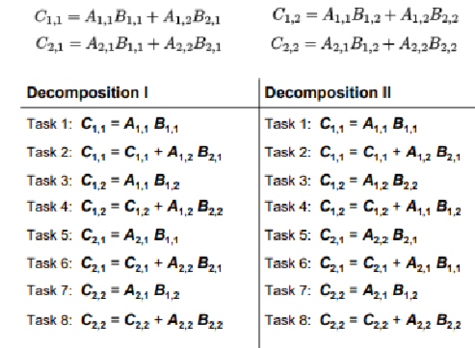
Continue…

Slide 15
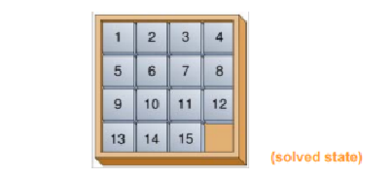
Exploratory Decomposition
• In many cases, the decomposition of the problem goes hand-in hand with its execution.
• These problems typically involve the exploration (search) of a state space of solutions.
• Problems in this class include a variety of discrete optimization problems, theorem proving, game playing, etc. E.g., the 15-square puzzle:

Slide 16
Speculative Decomposition
In some applications, dependencies between tasks are not known in advance.
For such applications, it is impossible to identify independent tasks.
There are generally two approaches to dealing with such applications: conservative approaches, which identify independent tasks only when they are guaranteed not to have dependencies, and, optimistic approaches, which schedule tasks even when they may potentially be erroneous.
Conservative approaches may yield little concurrency, and optimistic approaches may require roll-back mechanism in the case of an error

Slide 17
Thankyou ☺

